Slide 1
Reasoning in LLMs
Slides adapted are adapted from various sources including from Elvis Saravia

Slide 2
Reasoning
The process of drawing conclusions based on available information.

Slide 3
Types of Reasoning
Deductive
  is a type of reasoning in which a conclusion is drawn based on the truth of the premises.
  the conclusion must necessarily follow from the premises, meaning that if the premises are true, the conclusion must also be true.
For example:
•Premise: All mammals have kidneys.
• Premise: All whales are mammals.
• Conclusion: All whales have kidneys.
https://arxiv.org/abs/2212.10403

Slide 4
Types of Reasoning
Inductive reasoning
  is a type of reasoning in which a conclusion is drawn based on observations or evidence.
  the conclusion is likely to be true based on the available evidence, but it is not necessarily certain.
For example:
• Observation: Every time we see a creature with wings, it is a bird.
• Observation: We see a creature with wings.
• Conclusion: The creature is likely to be a bird.
https://arxiv.org/abs/2212.10403

Slide 5
Types of Reasoning
Abductive reasoning.
  is a type of reasoning in which a conclusion is drawn based on the best explanation for a given set of observations.
  the conclusion is the most likely explanation based on the available evidence, but it is not necessarily certain.
For example:
• Observation: The car cannot start and there is a puddle of liquid under the engine.
• Conclusion: The most likely explanation is that the car has a leak in the radiator.
https://arxiv.org/abs/2212.10403

Slide 6
Types of Reasoning
Abductive: Seeing a wet road and deducing it probably rained recently.
Inductive: Observing that the road gets wet every time it rains, and concluding that rain causes the road to be wet.
Deductive: ?
Notes:
While inductive reasoning draws general conclusions that apply to many situations, abductive conclusions are confined to the particular observations in question.

Slide 7
Reasoning Problems
Q: If there are 3 cars in the parking lot and 2 more cars arrive, how many cars are in the parking lot?
Q: Take the last letters of the words in "Elon Musk" and concatenate them
Q: What home entertainment equipment requires cable?
Answer Choices: (a) radio shack
(b) substation (c) television (d) cabinet
A: The answer is nk.
A: The answer is 5
A: The answer is (c).
Arithmetic Reasoning (AR)
(+ − ×÷…)
Symbolic Reasoning (SR)
Commonsense Reasoning (CR)

Slide 8
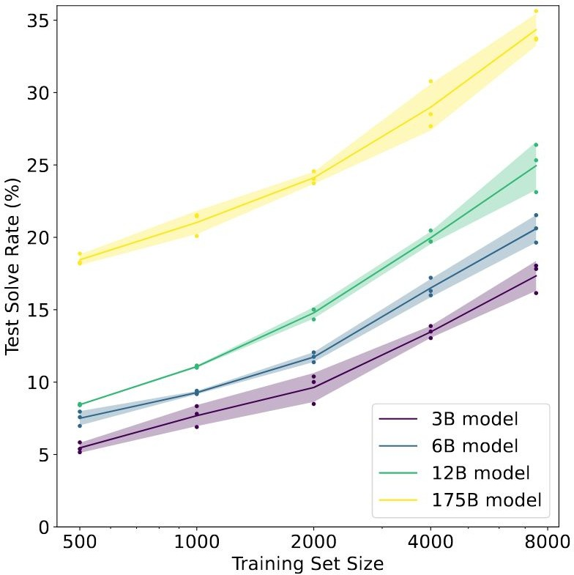
Reasoning Problems
Fine-tune GPT-3 on GSM8K (arithmetic): (Cobbe et al. 2021)
Conjecture: to achieve > 80%, needs 100 times more fine-tuning data for 175B model

Slide 9
Reasoning Problems
Scaling up language model size does not efficiently achieve high performances, for Arithmetic Reasoning (AR), CommonSense Reasoning (CR) and Symbolic Reasoning (SR) tasks.

Slide 10
Reasoning Problems
Scaling up language model size does not efficiently achieve high performances, for Arithmetic Reasoning (AR), CommonSense Reasoning (CR) and Symbolic Reasoning (SR) tasks.
Proposed solution: chain of thought prompting

Slide 11
Chain of Thought Prompting

Slide 12
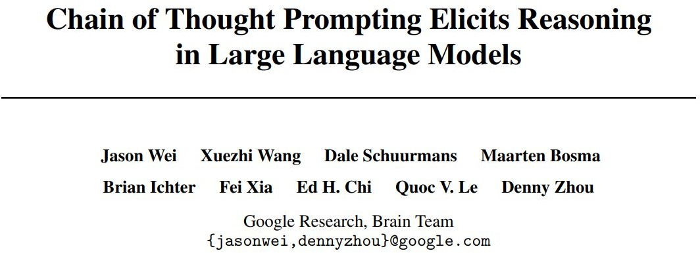
Chain of Thought (CoT)
Few-Shot CoT

Slide 13
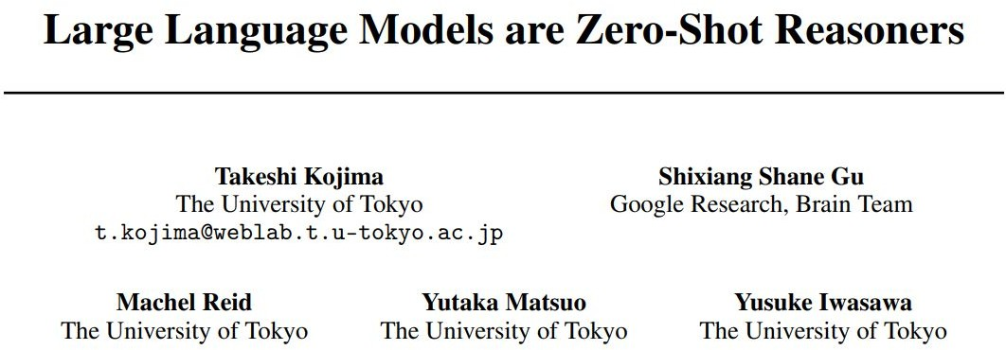
Chain of Thought (CoT)
Few-Shot CoT
Zero-Shot CoT

Slide 14
Chain of Thought (CoT)
Definition:
A chain of thought is a series of intermediate natural language reasoning steps that lead to the final output.

Slide 15
Elements of a Prompt
A prompt is composed with the following components:
  Instructions
  Context
  Input data
  Output indicator
Classify the
Text: I think the food was okay.
text into neutral, negative or positive
Sentiment:

Slide 16
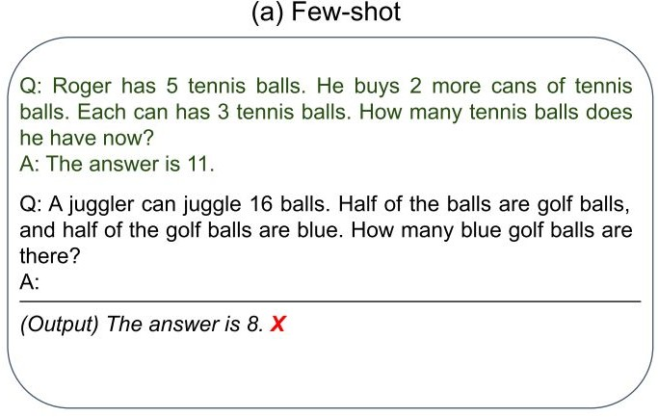
Chain of Thought (CoT)
Examples

Slide 17
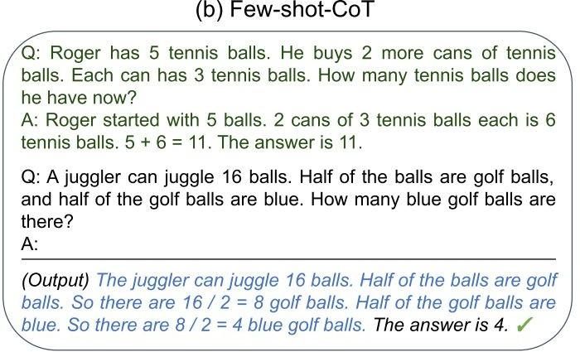
Chain of Thought (CoT)
（Wei et al., 2022）
Examples
CoT Examples
Step-by-step Answer

Slide 18
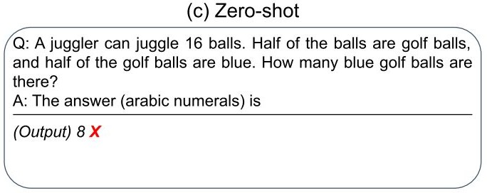
Chain of Thought (CoT)
（Wei et al., 2022）
Examples
CoT Examples
Step-by-step Answer

Slide 19
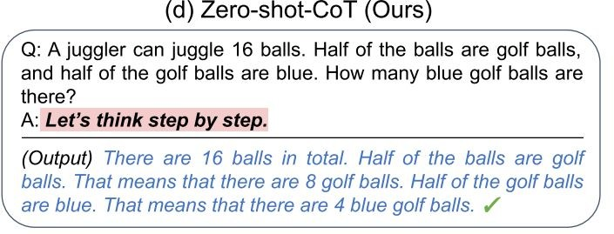
Chain of Thought (CoT)
（Wei et al., 2022）
Examples
CoT Examples
Step-by-step Answer
（KoJima et al., 2022）
Two-stage Prompting Step-by-step Answer

Slide 20
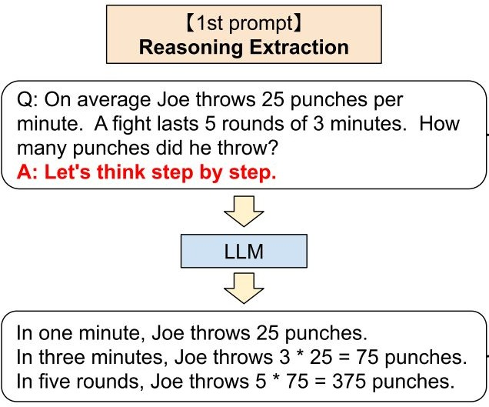
Zero-Shot Chain of Thought (CoT)
For zero-shot CoT, a two-stage prompting is applied:
Question Trigger1
Reasoning Path

Slide 21
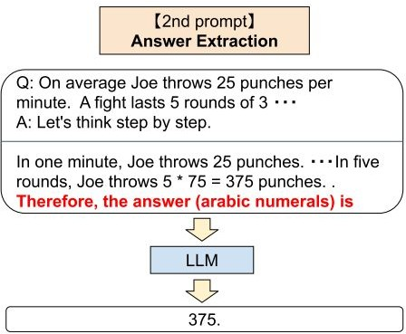

Zero-Shot Chain of Thought (CoT)
For zero-shot CoT, a two-stage prompting is applied:
Question Trigger1
Question
+Trigger1
Reasoning Path Trigger2
Reasoning Path
Answer

Slide 22
Experiments

Slide 23
Models
Pre-trained LLMs:
Instruct GPT-3 (ada 350M, babbage 1.3B, curie 6.7B, and davinci 175B) (Ouyang et al., 2022)
PaLM (8B, 62B, 540B) (Chowdhery et al., 2022)
LaMDA (422M, 2B, 8B, 68B, 137B) (Thoppilan et al., 2022)
GPT-3 (ada 350M, babbage 1.3B, curie 6.7B, davinci 175B)
GPT-2 (1.5B)
GPT-Neo (2.7B), GPT-J (6B), T0 (11B) (Sanh et al., 2022), OPT (13B) (Zhang et al., 2022)

Slide 24
Experiments
Arithmetic Reasoning

Slide 25
Free Response - Few-Shot CoT Prompt Exemplar
Free Response
Manually composed 8 exemplars
Q: If there are 3 cars in the parking lot and 2 more cars arrive, how many cars are in the parking lot?
A: There are originally 3 cars. 2 more cars arrive. 3 + 2 = 5. The
answer is 5.
（Wei et al., 2022）

Slide 26
Free Response - Few-Shot CoT Prompt Exemplar
Free Response
Free Response
Q: If there are 3 cars in the parking lot and 2 more cars arrive, how many cars are in the parking lot?
Q: Olivia has $23. She bought five bagels for $3 each. How much money does she have left?
A: There are originally 3 cars. 2 more cars arrive. 3 + 2 = 5. The
answer is 5.
A: Olivia had 23 dollars. 5 bagels for 3 dollars each will be 5 x 3 = 15 dollars. So she has 23 - 15 dollars left. 23 - 15 is 8. The answer is 8.
（Wei et al., 2022）
（Wei et al., 2022）
You can have one or more equations.

Slide 27
Free Response - Few-Shot CoT Prompt Exemplar
Free Response
Free Response
Q: If there are 3 cars in the parking lot and 2 more cars arrive, how many cars are in the parking lot?
Q: Olivia has $23. She bought five bagels for $3 each. How much money does she have left?
A: There are originally 3 cars. 2 more cars arrive. 3 + 2 = 5. The
answer is 5.
A: Olivia had 23 dollars. 5 bagels for 3 dollars each will be 5 x 3 = 15 dollars. So she has 23 - 15 dollars left. 23 - 15 is 8. The answer is 8.
（Wei et al., 2022） （Wei et al., 2022）
Equations can be incomplete and combined math with words.

Slide 28
Free Response - Few-Shot CoT Prompt Exemplar
Free Response
Q: If there are 3 cars in the parking lot and 2 more cars arrive, how many cars are in the parking lot?
A: There are originally 3 cars. 2 more cars arrive. 3 + 2 = 5. The
answer is 5.
Manually composed 8 exemplars
All contains equations with flexible formats
Benchmarked on:
  GSM8K (Cobbe et al. 2021)
  SVAMP (Patel et al., 2021)
  MAWPS (Koncel-Kedziorski et al., 2016)
（Wei et al., 2022）

Slide 29
Multiple Choice - Few-Shot CoT Prompt Exemplar
Multiple Choice
Multiple Choice
Q: A person is traveling at 20 km/hr and reached his destiny in 2.5 hr then find the distance?
Answer Choices: (a) 53 km (b) 55 km (c) 52 km (d) 60 km (e) 50 km
Q: If a / b = 3/4 and 8a + 5b = 22,then find the value of a.
Answer Choices: (a) 1/2 (b) 3/2 (c) 5/2 (d) 4/2 (e) 7/2
A: If a / b = 3/4, then b = 4a / 3. So 8a + 5(4a / 3) = 22. This simplifies to 8a + 20a / 3 = 22, which means 44a / 3 = 22. So a is equal to 3/2. The answer is (b).
A: The distance that the person traveled would have been 20 km/hr * 2.5 hrs = 50 km. The answer is (e).
The exemplars have various formats.

Slide 30
Multiple Choice - Few-Shot CoT Prompt Exemplar
Multiple Choice
Q: A person is traveling at 20 km/hr and reached his destiny in 2.5 hr then find the distance?
Answer Choices: (a) 53 km (b) 55 km (c) 52 km (d) 60 km (e) 50 km
A: The distance that the person traveled would have been 20 km/hr * 2.5 hrs = 50 km. The answer is (e).
4 exemplars, whose questions, intermediate reasoning, and answers are from training set
Exemplars have flexible formats
Benchmarked on AQuA-RAT (Ling et al., 2017)

Slide 31
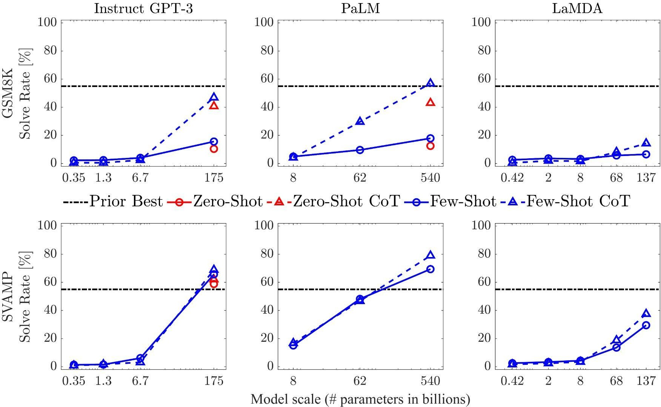
Arithmetic Reasoning - Results
GSM8K
Josh decides to try flipping a house. He buys a house for
$80,000 and then puts in $50,000
in repairs. This increased the value of the house by 150%. How much profit did he make?
SVAMP
Each pack of dvds costs 76 dollars. If there is a discount of 25 dollars on each pack. How much do you have to pay to buy each pack?

Slide 32
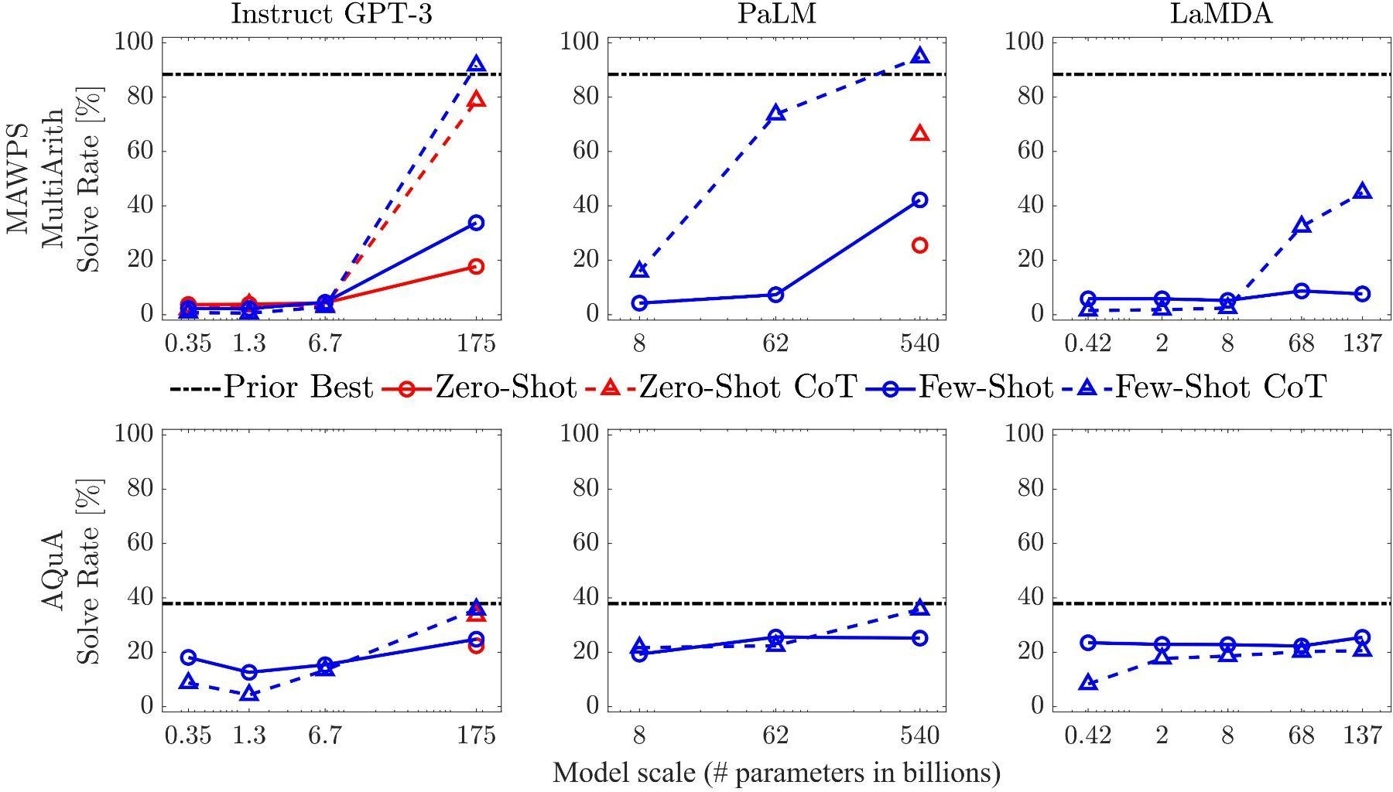
Arithmetic Reasoning - Results
MAWPS - MultiArith The school cafeteria ordered 42 red apples and 7 green apples for students lunches. But, if only 9 students wanted fruit, how many extra did the cafeteria end up with?
AQuA-RAT
A person is traveling at 20 km/hr and reached his destiny in 2.5 hr then find the distance?
Answer Choices: (a) 53 km (b)
55 km (c) 52 km (d) 60 km (e) 50 km

Slide 33
Arithmetic Reasoning - Results
MAWPS - MultiArith The school cafeteria ordered 42 red apples and 7 green apples for students lunches. But, if only 9 students wanted fruit, how many extra did the cafeteria end up with?
AQuA-RAT
A person is traveling at 20 km/hr and reached his destiny in 2.5 hr then find the distance?
Answer Choices: (a) 53 km (b)
55 km (c) 52 km (d) 60 km (e) 50 km

Slide 34
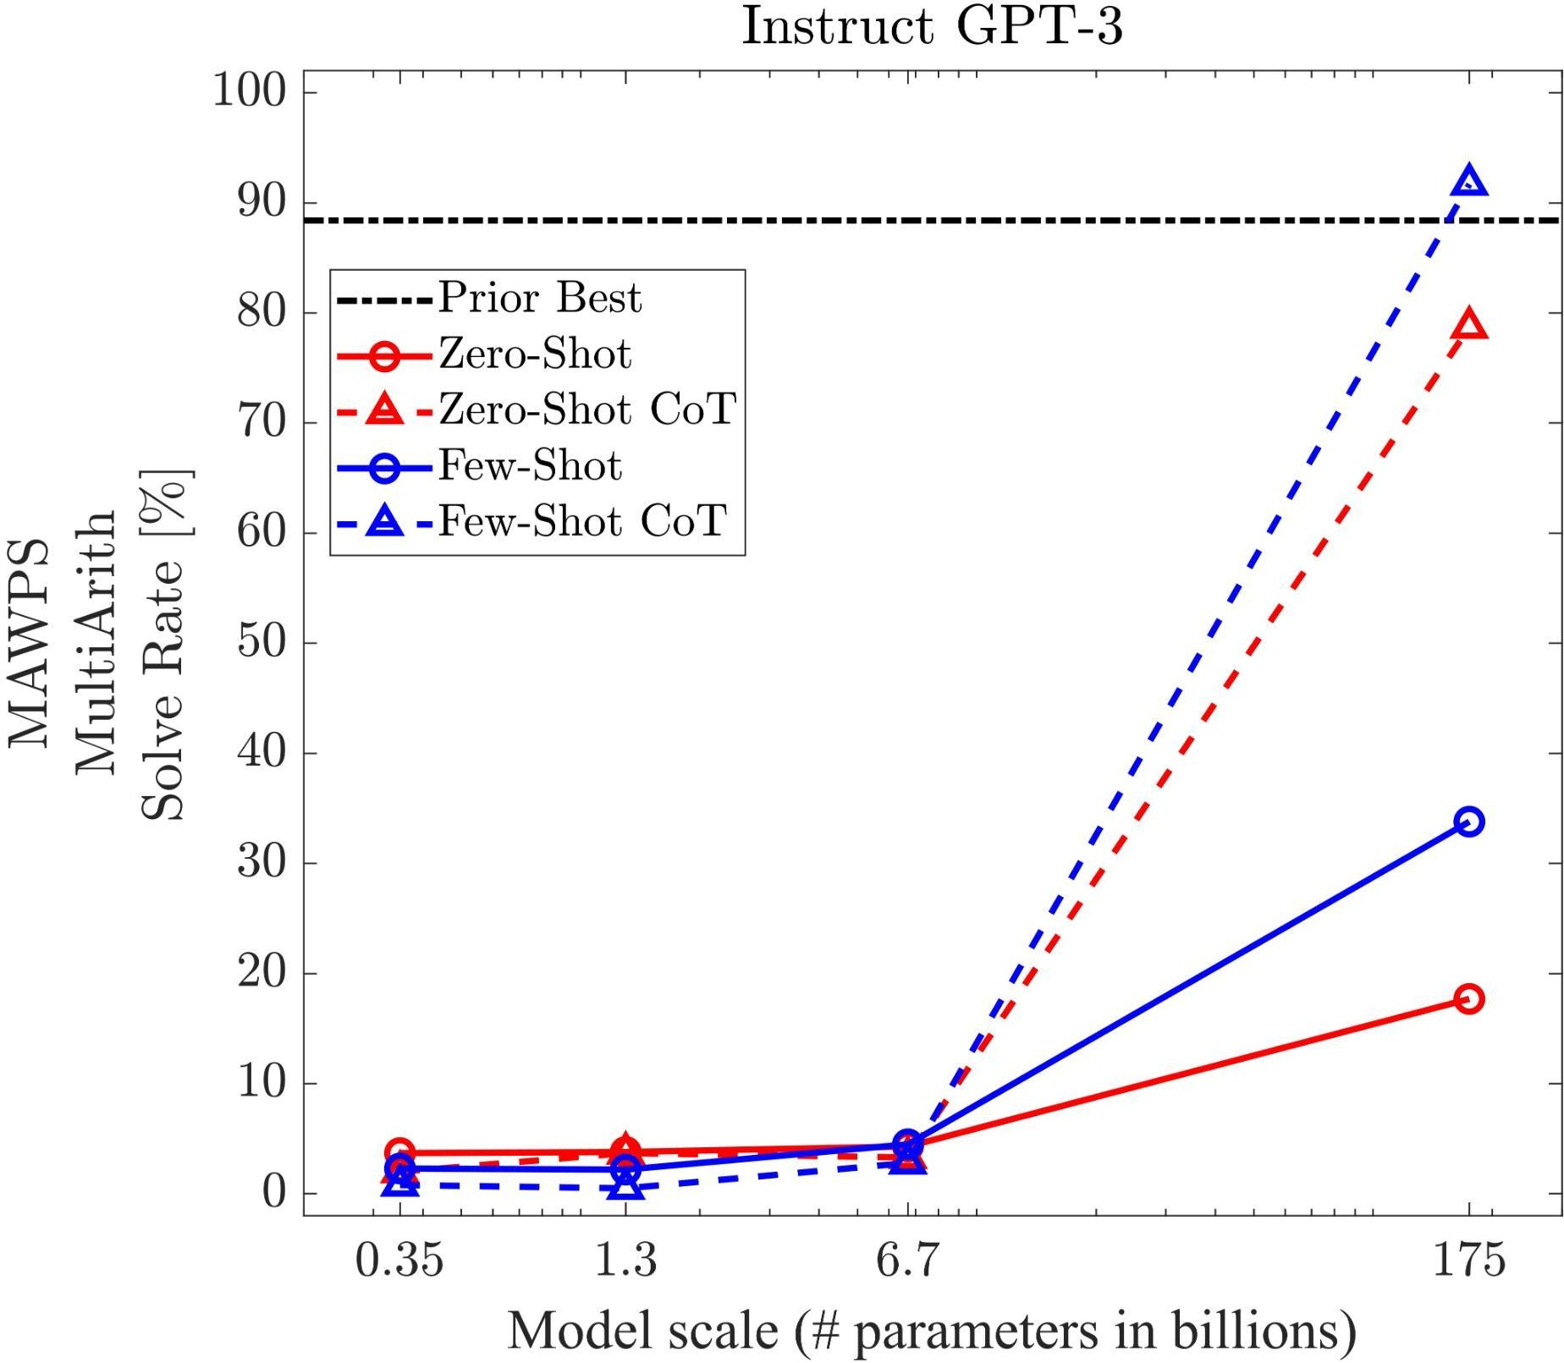
Arithmetic Reasoning - Observations
Both zero-shot and few-shot chain of thought promptings are emergent abilities of model scale.
They do not positively impact performance for small models, but start to yield performance gains when used with models with more than ∼100B parameters.
Few-shot CoT achieves better performance on LLM than zero-shot CoT.
Instruct GPT-3: text-davinci-002 achieves similar performance as PaLM 540B model

Slide 35
Experiments
Symbolic Reasoning

Slide 36
Symbolic Reasoning - Last Letter Concatenation
Last letter concatenation
Q: Take the last letters of the words in "Elon Musk" and concatenate them
A: The last letter of "Elon" is "n". The last letter of "Musk" is "k".
Concatenating them is "nk". The answer is nk.
Generate full names by randomly concatenating names from the top
one-thousand first and last names from name census data
4 exemplars with strict format

Slide 37
Symbolic Reasoning - Coin Flip
Coin Flip
Coin Flip
Q: A coin is heads up. Tom does not flip the coin. Mike does not flip the coin. Is the coin still heads up?
Q: A coin is heads up. Jamey flips the coin. Teressa flips the coin. Is the coin still heads up?
A: The coin was flipped by no one. So the coin was flipped 0 times. The coin started heads up, and it was not flipped, so it is still heads up. So the answer is yes.
A: The coin was flipped by Jamey and Teressa. So the coin was flipped 2 times, which is an even number. The coin started heads up, so after an even number of flips, it will still be heads up. So the answer is yes.
8 exemplars with strict format.

Slide 38
Symbolic Reasoning - In & Out-of-domain Test
Last letter concatenation
Coin Flip
Q: Take the last letters of the words in "Elon Musk" and concatenate them
Q: A coin is heads up. Tom does not flip the coin. Mike does not flip the coin. Is the coin still heads up?
A: The last letter of "Elon" is "n". The last letter of "Musk" is "k".
Concatenating them is "nk". The answer is nk.
A: The coin was flipped by no one. So the coin was flipped 0 times. The coin started heads up, and it was not flipped, so it is still heads up. So the answer is yes.
In-domain test set: examples had the same number of steps as the few-shot exemplars
Out-of-domain (OOD) test set: examples had more steps than those in the exemplars.

Slide 39
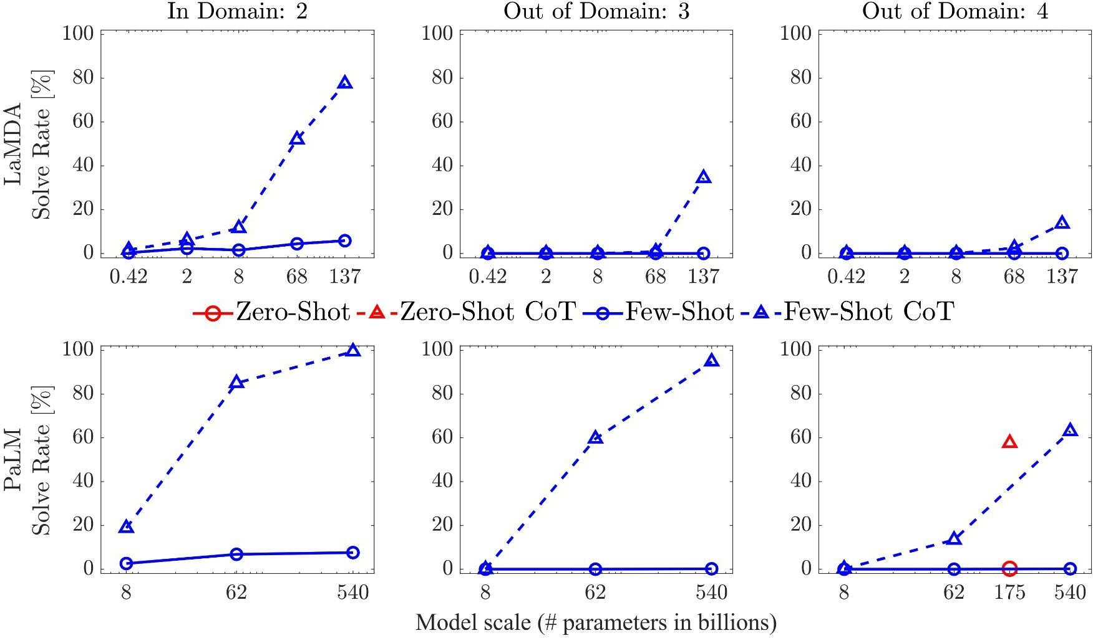
Symbolic Reasoning - Last Letter Concatenation
In-Domain
Take the last letters of the words in "Elon Musk" and concatenate them.
Out-of-Domain
Take the last letters of the words in "Johann Sebastian Bach" and concatenate them.
*Zero-Shot results use Instruct-GPT-3 175B text-davinci-002 model.

Slide 40
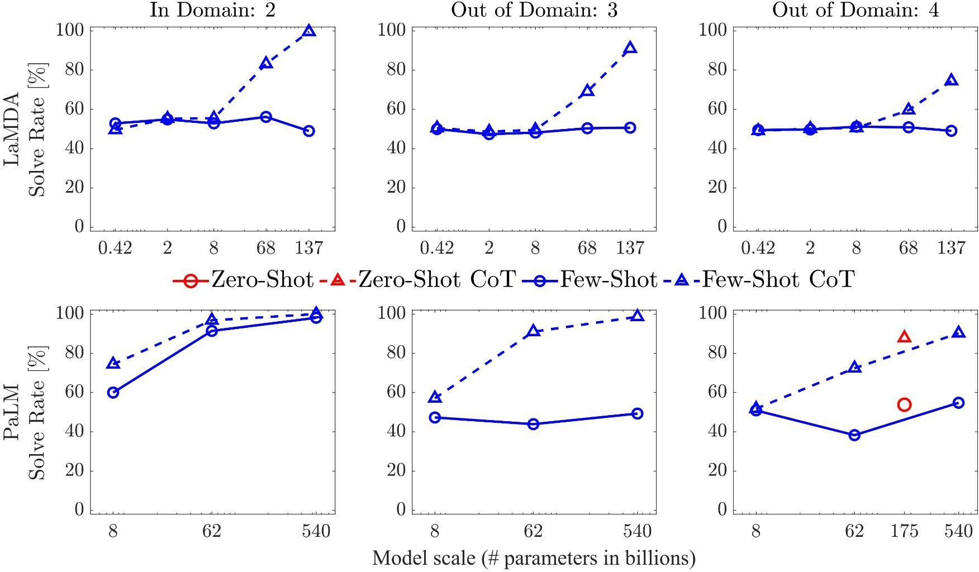
Symbolic Reasoning - Coin Flip
In-Domain
A coin is heads up. Tom does not flip the coin. Mike does not flip the coin. Is the coin still heads up?
Out-of-Domain
A coin is heads up. Tom does not flip the coin. Mike does not flip the coin. Jake flips the coin. Is the coin still heads up?
*Zero-Shot results use Instruct-GPT-3 175B text-davinci-002 model.

Slide 41
Symbolic Reasoning - Observations
Standard prompting fails out-of-domain tests for both tasks.
Few-shot CoT prompting is emergent abilities of model scale.
CoT does not positively impact performance for small models, but start to yield performance gains when using models with more than ∼100B parameters for both in-domain and out-of-domain tests.
Zero-shot CoT using Instruct-GPT-3 175B achieves the similar performance as few-shot
CoT in both tasks using 540B PaLM model.

Slide 42
Commonsense Reasoning - Toy Problems
CSQA (Talmor et al., 2019)
Q: What home entertainment equipment requires cable?
Answer Choices: (a) radio shack (b) substation (c) television (d) cabinet
A: The answer is (c).
Sport Understanding
Q: Is the following sentence plausible? “Jamel Murray was perfect from the line.”
A: The answer is yes.
StrategyQA (Geva et al., 2021)
Q: Did Aristotle use a laptop?
A: The answer is no.
Date Understanding
Q: 2015 is coming in 36 hours. What is the date one week from today in MM/DD/YYYY
A: So the answer is 01/05/2015.

Slide 43
Commonsense Reasoning - Toy Problems
SayCan Robot Planning
Locations = [counter, table, user, trash, bowl].
Objects = [7up, apple, kettle chips, tea, multigrain chips, coke, lime soda, jalapeno chips, rice chips, orange, grapefruit soda, pepsi, redbull, energy bar, sponge, water].
The robot can pick up items with pick(object) and put down items with put(object) as well as find objects or locations with find(). The robot can only understand the explicit locations and objects listed.
Human: How would you throw away a redbull?
Plan: 1. find(redbull), 2. pick(redbull), 3. find(trash), 4. put(redbull), 5. done().

Slide 44
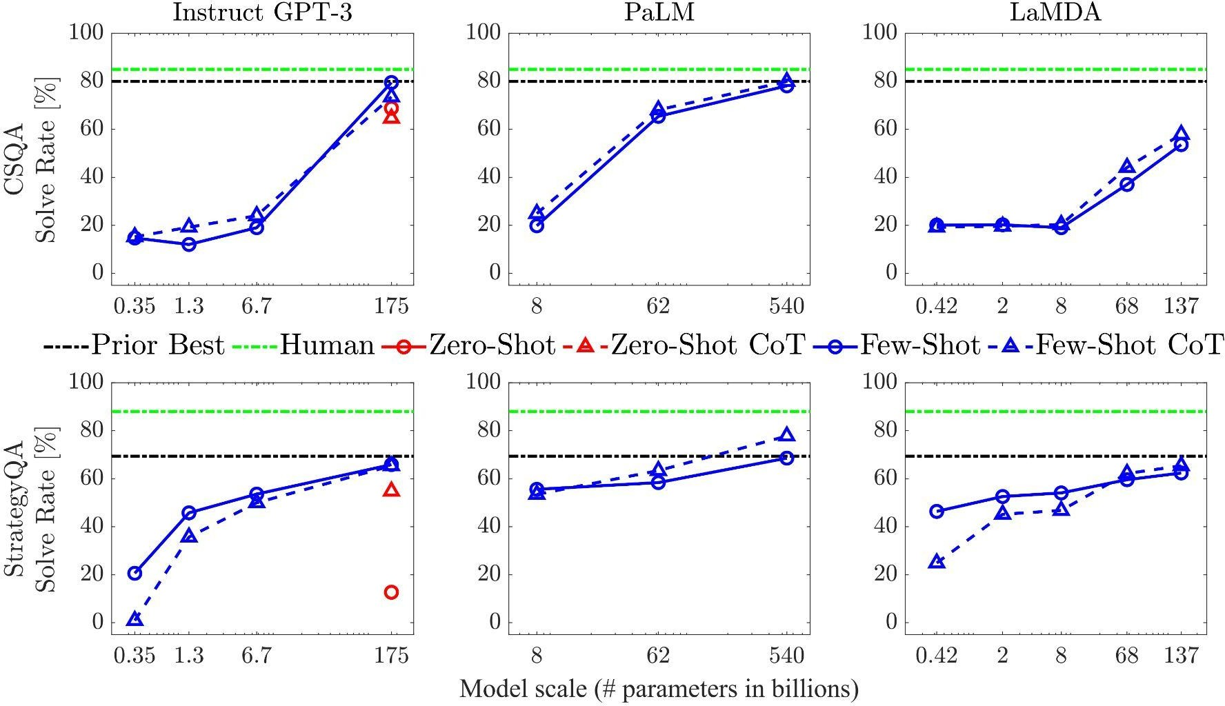
Commonsense Reasoning - Results

Slide 45
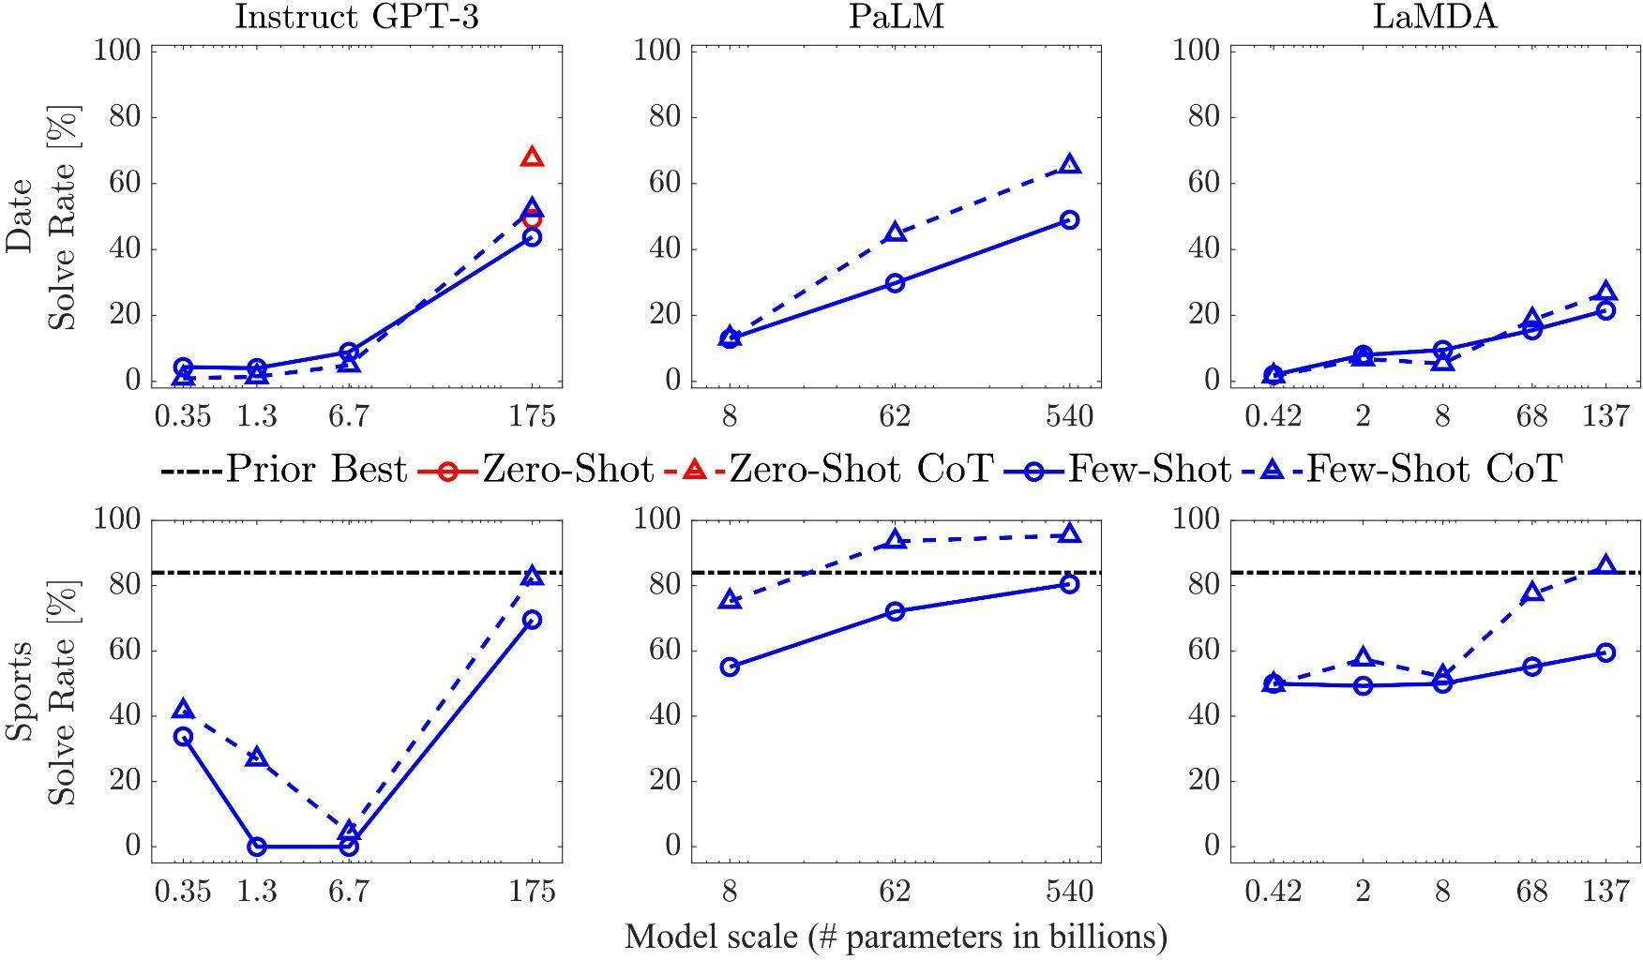
Commonsense Reasoning - Results

Slide 46
Commonsense Reasoning - Observations
For all tasks, scaling up model size improved the performance of standard prompting.
CoT prompting led to further gains, with improvements appearing to be largest for PaLM 540B.
CoT has minimal benefits on CSQA and StrategyQA tasks.
Few-shot achieves better performance than Zero-shot CoT on 175B GPT-3 model for CSQA and Strategy QA tasks, but Zero-shot CoT shows significant improvement for Date understanding task.

Slide 47
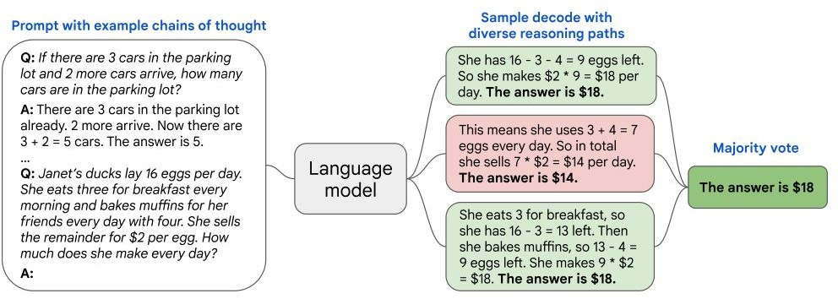
More Advances - Self-Consistency
Change greedy decode (single-path) to self-consistency (multi-path) in few-shot CoT:
Wang, Xuezhi, et al. "Self-consistency improves chain of thought reasoning in language models." arXiv preprint arXiv:2203.11171 (2022).

Slide 48
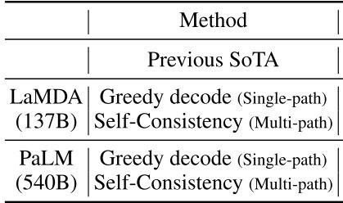
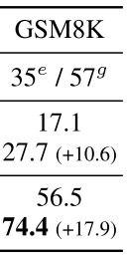
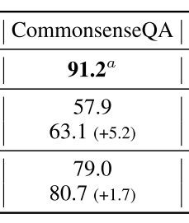
More Advances - Self-Consistency
Showcase results on AR, CR tasks:
Wang, Xuezhi, et al. "Self-consistency improves chain of thought reasoning in language models." arXiv preprint arXiv:2203.11171 (2022).

Slide 49
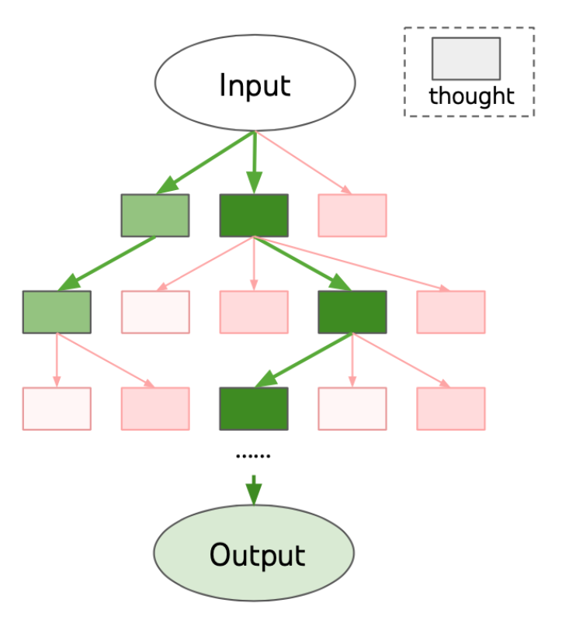
Tree of Thoughts (ToT)

Slide 50
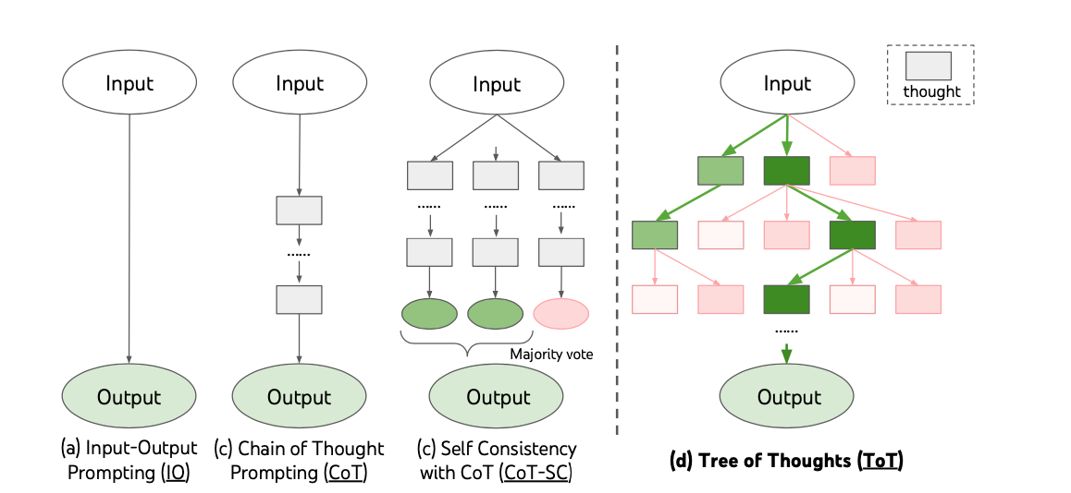
ToT vs IO, CoT, CoT-SC

Slide 51
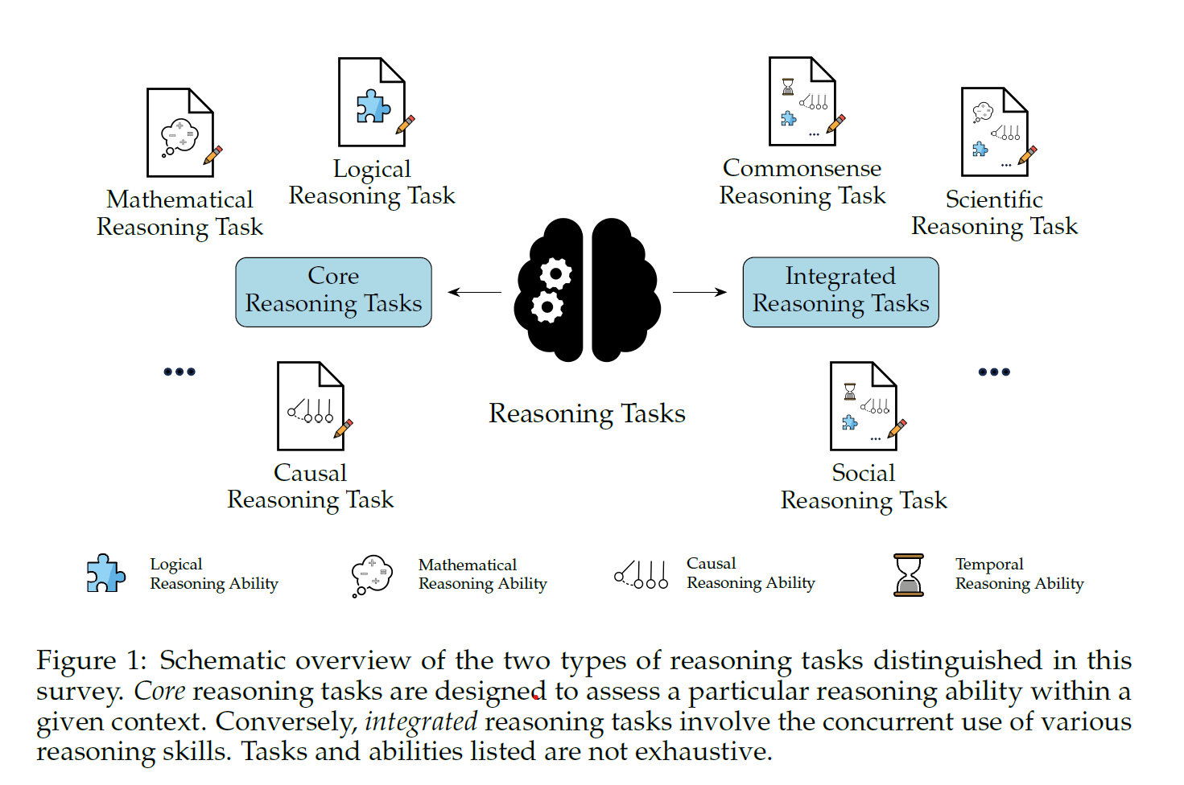
Different survey papers
Beyond Accuracy: Evaluating the Reasoning Behavior of
Large Language Models - A Survey, https://arxiv.org/abs/2404.01869

